Slide 1
Data Structure and Algorithm CSE-225
Dr. Mohammad Abu Yousuf
yousuf@juniv.edu

Slide 2
STACKS

Slide 3
What is STACKS ?
It is an ordered group of homogeneous items of elements. Elements are added to and removed from the top of the stack (the most recently added items are at the top of the stack). The last element to be added is the first to be removed (LIFO: Last In, First Out).
A stack is a list of elements in which an element may be inserted or deleted only at one end, called TOP of the stack. The elements are removed in reverse order of that in which they were inserted into the stack.

Slide 4
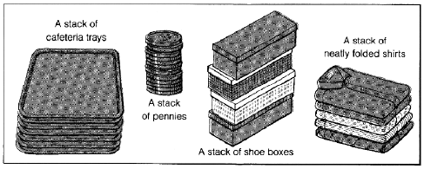
What is STACKS ?

Slide 5
Basic operations
These are two basic operations associated with stack:
Push() is the term used to insert/add an element into a stack.
Pop() is the term used to delete/remove an element from a stack.
There are two ways to represent Stack in memory. One is using array and other is using linked list.

Slide 6
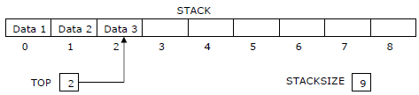
Array representation of stacks
Usually the stacks are represented in the computer by a linear array.
In the following algorithms/procedures of pushing and popping an item from the stacks, we have considered, a linear array STACK, a variable TOP which contain the location of the top element of the stack; and a variable STACKSIZE which gives the maximum number of elements that can be hold by the stack.

Slide 7
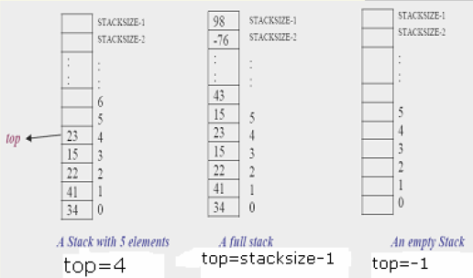
Array representation of stacks

Slide 8
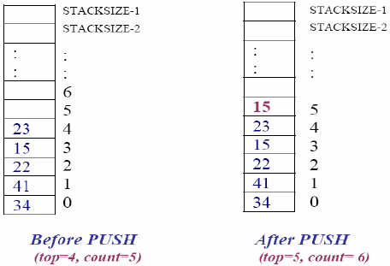
Push Operation
Push an item onto the top of the stack (insert an item)

Slide 9
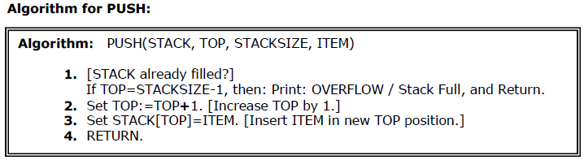
Push Operation
Push an item onto the top of the stack (insert an item)

Slide 10
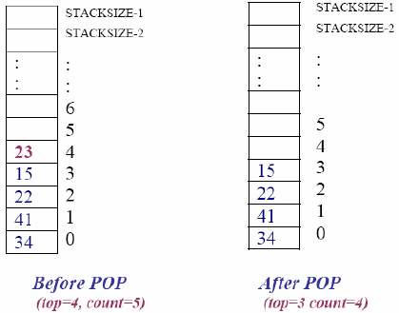
Pop Operation
Pop an item off the top of the stack (delete an item)

Slide 11
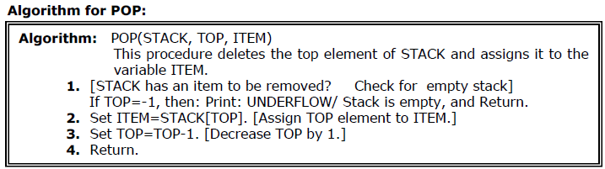
Pop Operation
Pop an item off the top of the stack (delete an item)

Slide 12
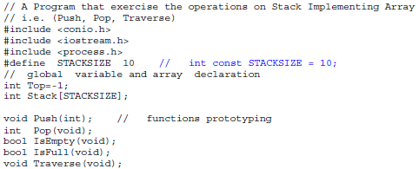
Here are the minimal operations we'd need for an abstract stack (and their typical names):
o Push: Places an element/value on top of the stack.
o Pop: Removes value/element from top of the stack.
o IsEmpty: Reports whether the stack is Empty or not.
o IsFull: Reports whether the stack is Full or not.

Slide 13
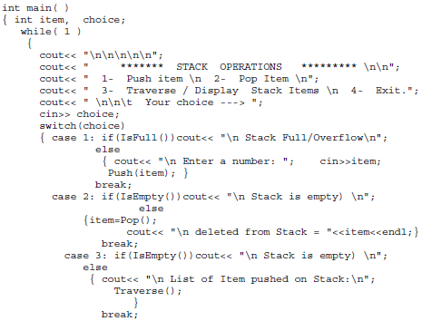

Slide 14
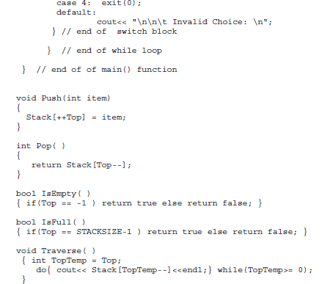

Slide 15

Application of the Stack (Arithmetic Expressions)
INFIX , POST FIX AND PRE FIX NOTATIONS :
Example: 3+4 (infix), 3 4 + (postfix), + 3 4 (prefix)
Stacks are used by compilers to help in the process of converting infix to postfix arithmetic expressions and also evaluating arithmetic expressions.
Arithmetic expressions consisting variables, constants, arithmetic operators and parentheses.

Slide 16

Application of the Stack (Arithmetic Expressions)
To evaluate a complex infix expression, a compiler would first convert the expression to postfix notation, and then evaluate the postfix version of the expression.
We use the following three levels of precedence for the five binary operations.

Slide 17
Application of the Stack (Arithmetic Expressions)
Example:
(66 + 2) * 5 – 567 / 42
to postfix
66 22 + 5 * 567 42 / –

Slide 18
Transforming Infix Expression into Postfix Expression
The following algorithm transform the infix expression Q into its equivalent postfix expression P. It uses a stack to temporary hold the operators and left parenthesis.
The postfix expression will be constructed from left to right using operands from Q and operators popped from STACK.

Slide 19
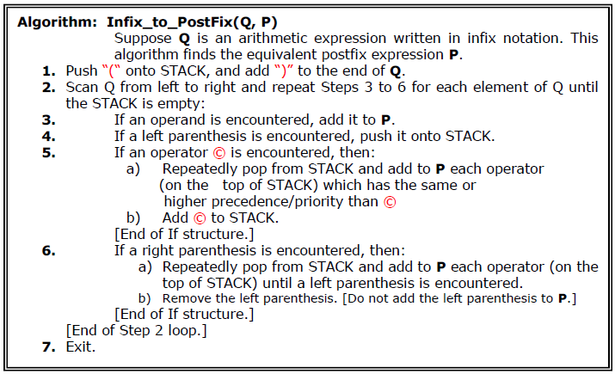
Transforming Infix Expression into Postfix Expression

Slide 20
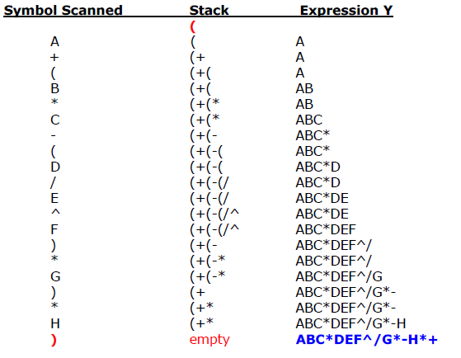
Convert Q: A+( B * C – ( D / E ^ F ) * G ) * H into postfix form showing stack status .
Now add “)” at the end of expression
A+( B * C – ( D / E ^ F ) * G ) * H ) and also Push a “(“ on Stack.
Example

Slide 21
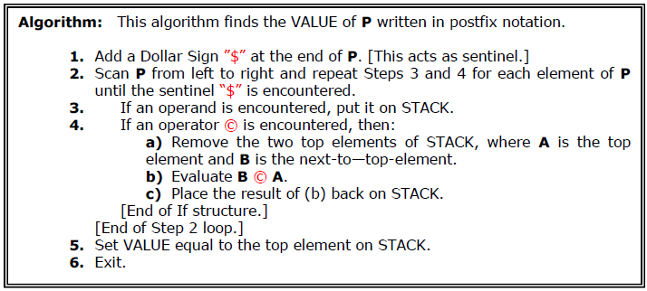
Evaluation of Postfix Expression
If P is an arithmetic expression written in postfix notation. This algorithm uses STACK to hold operands, and evaluate P.

Slide 22
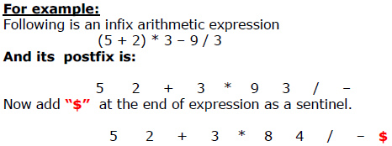
Evaluation of Postfix Expression

Slide 23
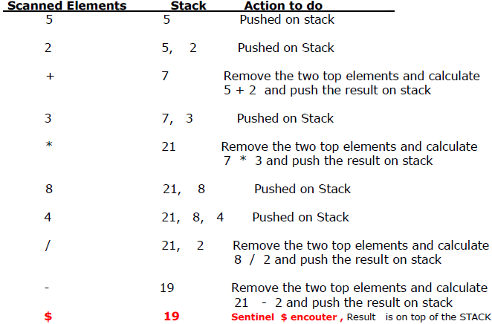
Evaluation of Postfix Expression

Slide 24
Thank you

